Slide 1
Microsoft365 Outlook
Event calendar scheduling

Slide 2
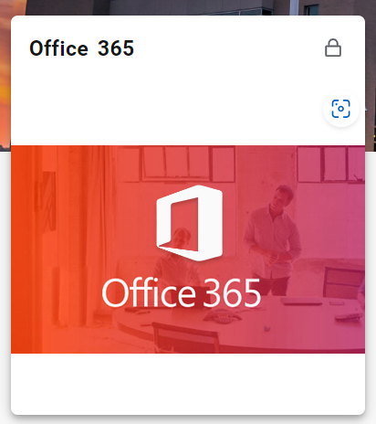
Log in to Outlook: Open your web browser and navigate to the Pierpont Portal on the web (Pierpont C&TC(wvnet.edu)).

Slide 3
Go to Calendar: Click on the "Calendar" icon located at the bottom left corner of the Outlook window to access your calendar.

Slide 4
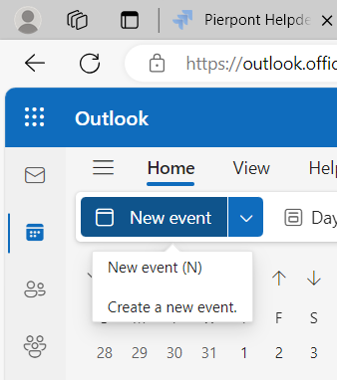
Create a New Meeting: Click on the "New event" button located at the top left corner of the calendar view. This will open a new event window.

Slide 5
Add Attendees: In the new event window, enter the email addresses of the attendees in the "Invite someone" field. You can also select attendees from your contacts list by clicking on the "People" icon.

Slide 6
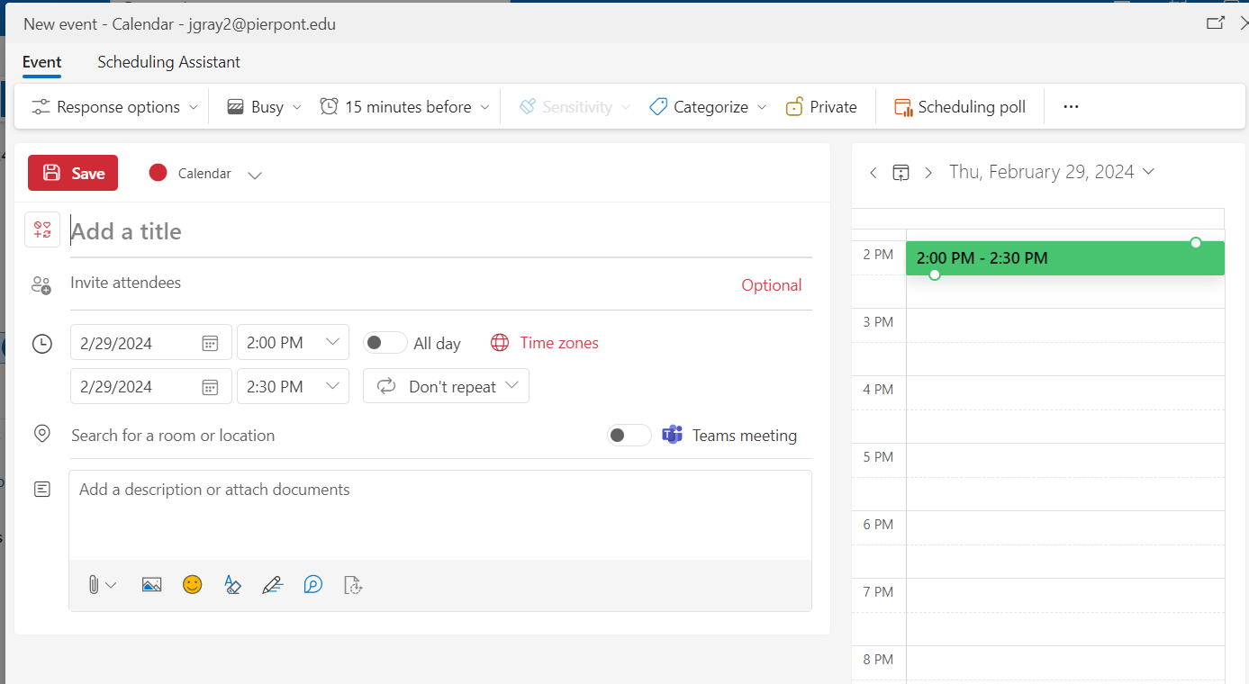
Set Date and Time: Choose the date and time for the meeting by clicking on the "Start time" and "End time" fields and selecting the desired date and time from the calendar and dropdown menus.

Slide 7
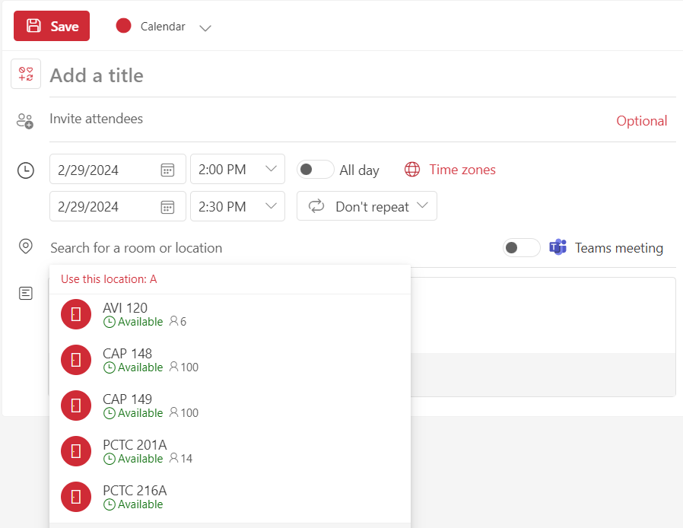
Add Location: In the event window, you should see a field labeled "Location." Click on this field to enter the location of the meeting. You can type in the address or name of the location.
Type the room name in the box the “Browse with Room Finder”
is not function properly

Slide 8
Set Reminder (Optional): If you want to set a reminder for the meeting, you can do so by clicking on the "Add a reminder" dropdown menu and selecting an appropriate option.

Slide 9
Add Meeting Details (Optional): You can add additional details about the meeting in the "Add a message to attendees" field. This could include the agenda, meeting objectives, or any other relevant information.

Slide 10
Send the Meeting Invitation: Once you have filled in all the necessary details, click on the "Send" button located at the top of the event window to send the meeting invitation to the attendees. They will receive an email with the meeting details and can accept or decline the invitation.

